Slide 1
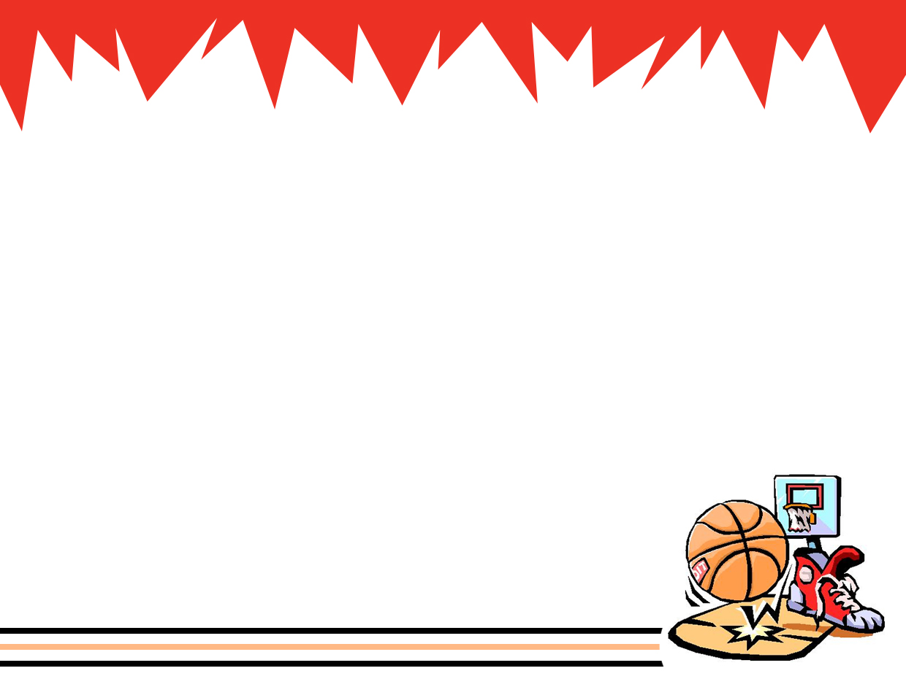
PHYSICS IN AMUSEMENT PARKS AND SPORTS (part 4)

Slide 3

ENERGY
Ability to do work
scalar
Unit: Joules

Slide 4
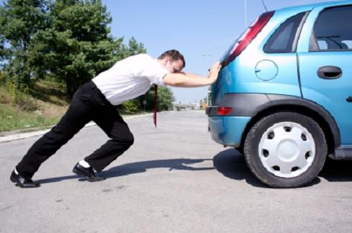
Work, W
amount of ENERGY transferred by a FORCE.
applied force over a certain displacement
W = F Δx cosθ
F = force
Δx = displacement
θ = angle between force and displacement
www.blogging4jobs.com

Slide 5
Positive Work
F
F
d
θ
d
F cos
θ
F cos θ has same direction as the displacement

Slide 6
Negative Work
F
d
F
d
θ
F cos
θ
F cos θ has opposite direction as the displacement

Slide 7
Zero work
F
d
d
F
Force is perpendicular to the displacement
cos 90° = 0

Slide 8

POWER, P
rate at which the work is done.
Unit: Watt
Δt = time
V = velocity

Slide 9
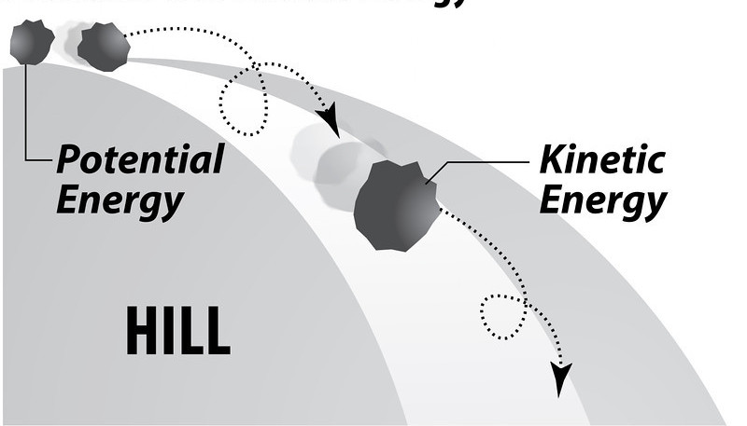
MECHANICAL ENERGY
Sum of all KINETIC ENERGY and POTENTIAL ENERGY of a system
need-media.smugmug.com

Slide 10
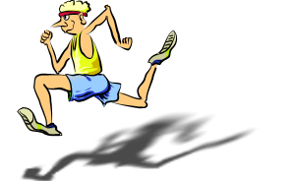
Kinetic Energy, KE
Is the energy associated to particles and systems that are moving.
KE = ½ mv²
m = mass
v = speed
resources.yesican-science.ca

Slide 11
Potential energy, PE
energy with respect to a certain position
PE = mgh
m = mass
g = acceleration due to gravity
h = height (with respect to a certain reference point)

Slide 12
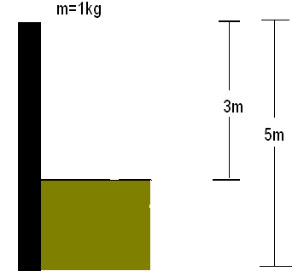
Potential energy, PE
PE₁=(1)(9.8)(3)
With respect to reference 1
PE₂= (1)(9.8)(5)
With respect to reference 2
Ref 1
Ref 2

Slide 13
Conservative Force
A force is conservative if the work it does on an object is dependent on the final and initial positions and independent of path taken. (e.g. force of gravity)
PE_{i}
W = PE_{i} – PE_{f}
Same
work !!!
PE_{f}

Slide 14
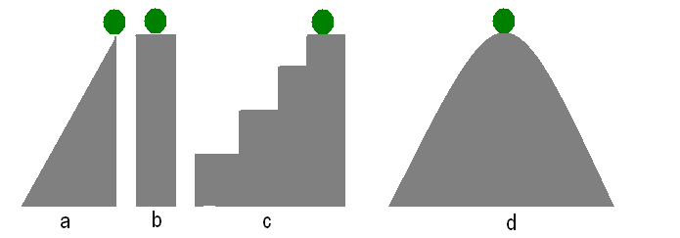
Question
Higher work done in moving the ball from the initial position to the final position?
final
initial

Slide 15
Answer
W = mgh_{i} – mgh_{f}
Same work
Same initial and final elevations = same work
final
initial

Slide 16
CONSERVATION OF MECHANICAL ENERGY
If frictional force and other dissipative mechanisms are disregarded then the total mechanical energy is constant
Applicable if the forces in the system are all conservative
ME₁ = ME₂
KE₁ + PE₁ = KE₂ + PE₂

Slide 17
CONSERVATION OF MECHANICAL ENERGY
V = 0 m/s
PE + KE = ME
10 J + 0 J = 10 J
PE is transformed to KE
8 J + 2 J = 10 J
2 J + 8 J = 10 J
0 J + 10 J = 10 J

Slide 18
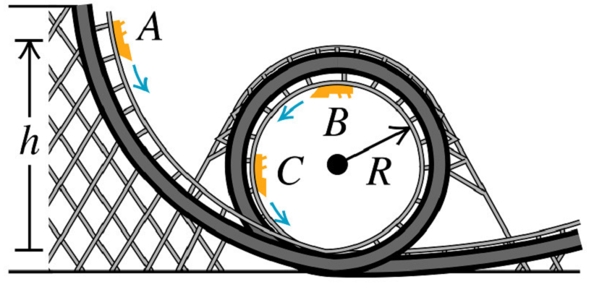
Frictionless Roller Coaster
Most roller coasters have no engine
The conversion of potential energy to kinetic energy is what drives the roller coaster

Slide 19
Conservative System: Frictionless Roller Coaster
PE + KE = ME
10 J + 0 J = 10 J
8 J + 2 J = 10 J
2 J + 8 J = 10 J
0 J + 10 J = 10 J

Slide 20
Frictionless Roller Coaster
“D” should be less than “h”
D = 2R

Slide 21
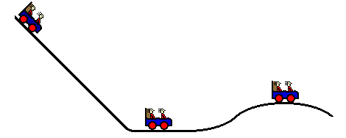
Compute for V (at H=10)?
V_{i}=0
v = ?
H= 50m
H= 10m
PE=0

Slide 22
Compute for V (at H=10)?
V_{i}=0
PE₁ + KE₁ = ME
PE₂ + KE₂ = ME
H= 50m
v = ?
H= 10m
PE=0

Slide 23
Solution
PE₁ + KE₁ = PE₂ + KE₂
mgh₁ + 0 = mgh₂ + mv²/2

Slide 24
Conservative System: Pendulum
KE = 0 J
KE = 0 J
PE = 0

Slide 25
LINEAR MOMENTUM
A particle's momentum p is defined as the product of its mass and velocity
p = m v
SI unit: kg m/s

Slide 26
Momentum
Newton's Second Law can be written in terms of the momentum of a particle.

Slide 27
Impulse-Momentum Theorem
Impulse

Slide 28

IMPULSE
Impulse is the change in momentum of an object during collision

Slide 29
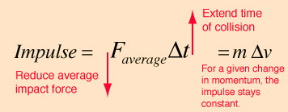
Impulse-momentum Theorem

Slide 30
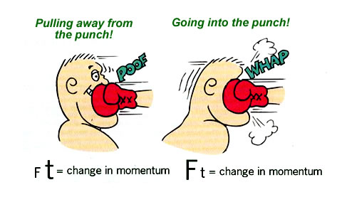
Impulse-momentum Theorem
Longer collision time, lower force

Slide 31
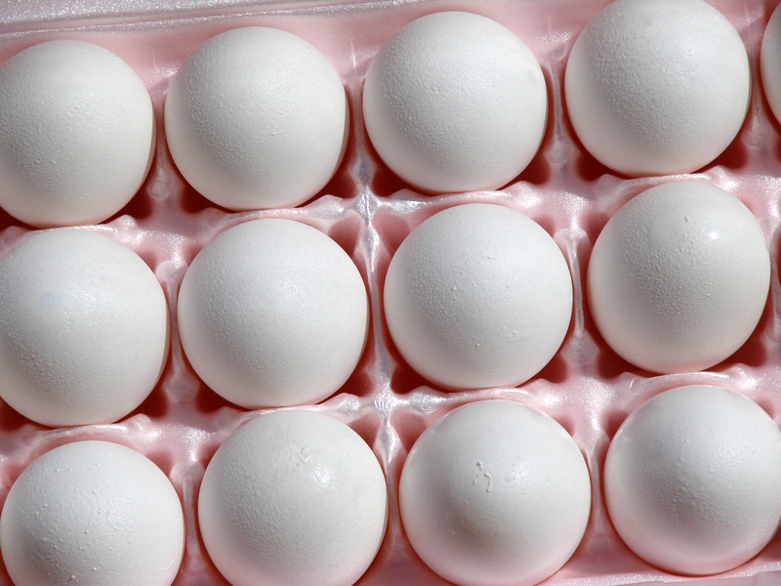
Egg Catching Activity
How to catch an egg without breaking its shell?

Slide 32
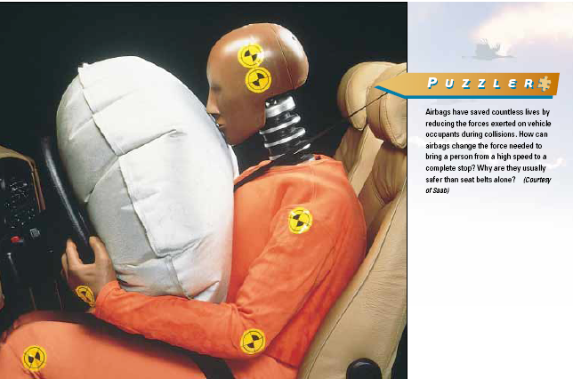
BLAM!
What is the purpose of the air bag in cars?
Minimize the collision force by prolonging the collision time

Slide 33
LAW OF CONSERVATION OF MOMENTUM
If the net external force on a system is zero, the total momentum is conserved.
P_{initial} = P_{final}

Slide 34
Before Collision
After Collision
m₁ = 2 kg
v_{1a} = 0 m/s
m₂ = 2 kg
v_{2a} = 5 m/s
m₁ = 2 kg
v_{1b} = 5 m/s
m₂ = 2 kg
v_{2b} = 0 m/s
Rest
Rest
Moving
Moving
Total Momentum
m₁v_{1b} + m₁v_{1b}
(2kg*5m/s) + 0
Total Momentum
m₁v_{1a} + m₁v_{1a}
0 + (2kg*5m/s)

Slide 35
Newton’s Cradle
Balls with the same mass

Slide 36
Newton’s Cradle
Before Collision mv

Slide 37
Newton’s Cradle
After Collision
mv

Slide 38
Newton’s Cradle
Before Collision 2mv

Slide 39
Newton’s Cradle
After Collision
2mv

Slide 40
Newton’s Cradle
Before Collision 4mv

Slide 41
Newton’s Cradle
After Collision
4mv

Slide 42
Newton’s Cradle
Before Collision 6mv

Slide 43
Newton’s Cradle
After Collision
6mv

Slide 44
Two Types of Collision
Elastic Collision – Both the total kinetic energy and total momentum is conserved during collision
Inelastic Collision – total momentum is conserved but the total kinetic energy is not conserved during collision

Slide 45
Elastic Collision
Total Kinetic Energy is conserved
Before Collision
After Collision
Moving
Rest
Rest
Moving
KE_{B1} + KE_{B2}
KE_{A1} + KE_{A2}
5J + 0J
0J + 5J

Slide 46
Inelastic Collision
Total Kinetic Energy is not conserved
Before Collision
After Collision
Other Energy
Moving
Rest
Rest
Moving
KE_{A1} + KE_{A2} + E_{others}
KE_{B1} + KE_{B2}
0J + 3J + 2J
5J + 0J
KE has transformed to other kinds of Energy

